Slide 1
CalvertHealth Mini Tutorial
ED Universal Discharge
Must be viewed in Slide Show
(Slides are layered)

Slide 2

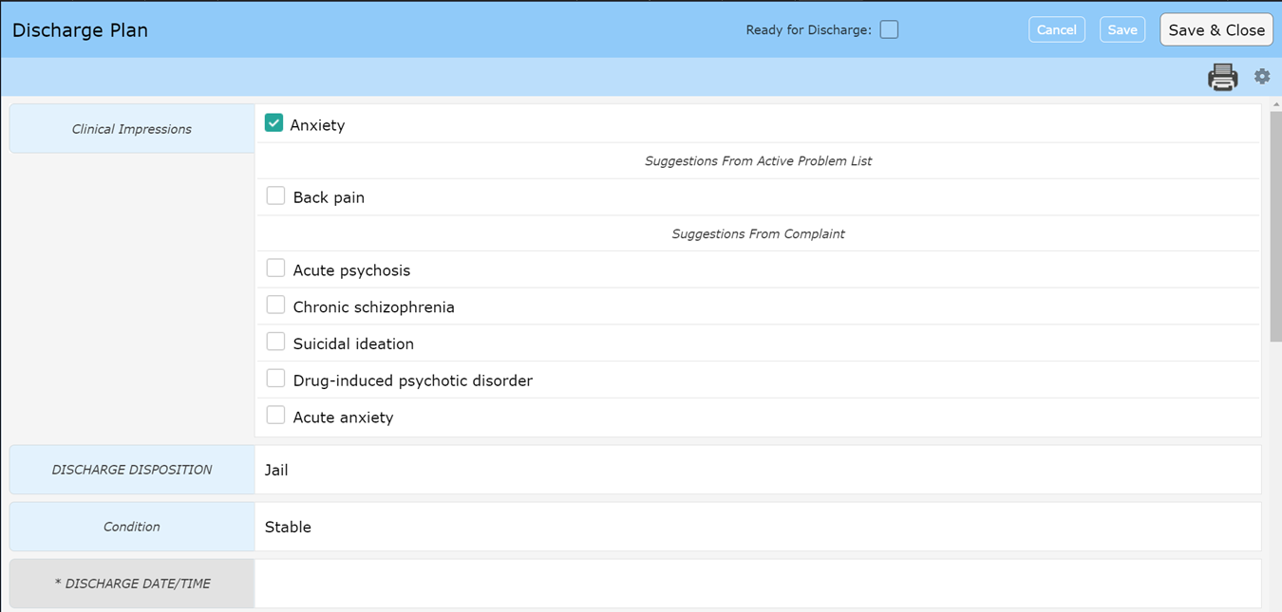

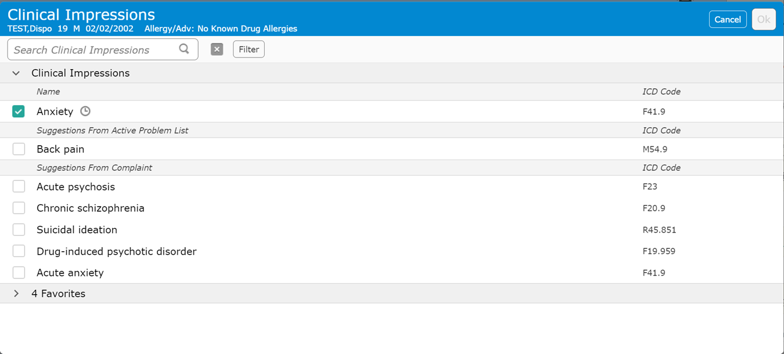



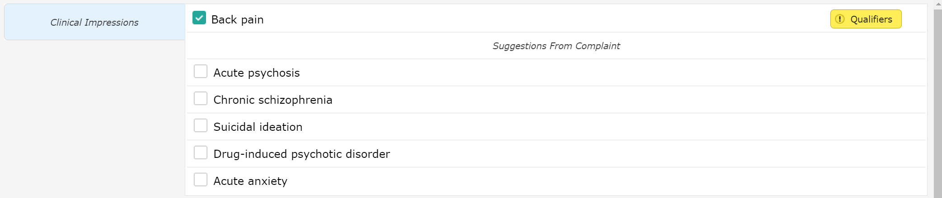
Universal Discharge
ED
Ready for Discharge – Flags the nurse
Specificity may need to be added to generate an ICD-10 Code
Clinical Impression
Click on Blue area to search for alternatives

Slide 3
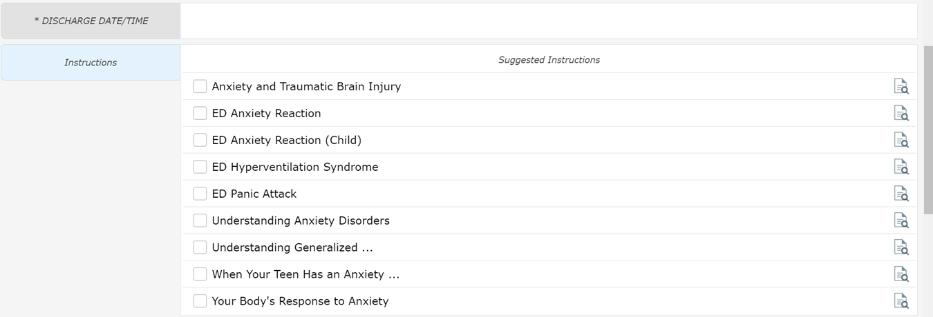
Universal Discharge
ED
Discharge Date/Time
  Nursing function – This field actually discharges the patient
Instructions
  Suggestions if recommended Clinical Impression selected
Clicking anywhere in this area will allow you to search for additional instructions

Slide 4
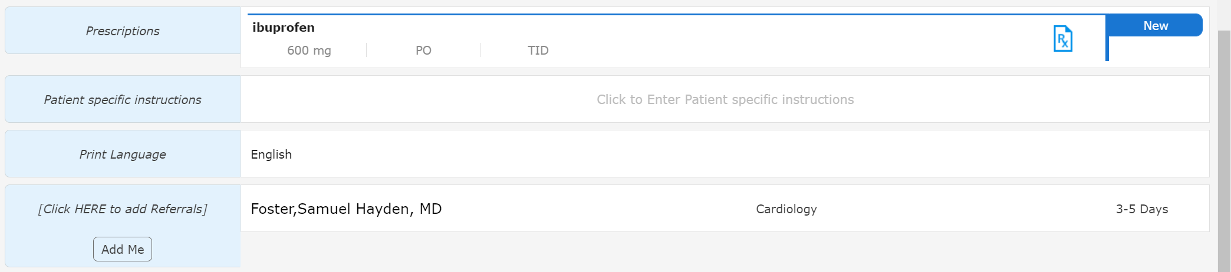
Universal Discharge
ED
This section has the same functionality as discussed “Prescriptions” Mini Tutorial
  The order may be different

Slide 5
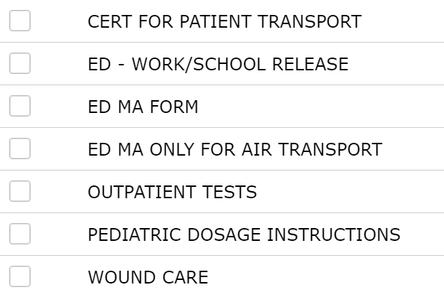
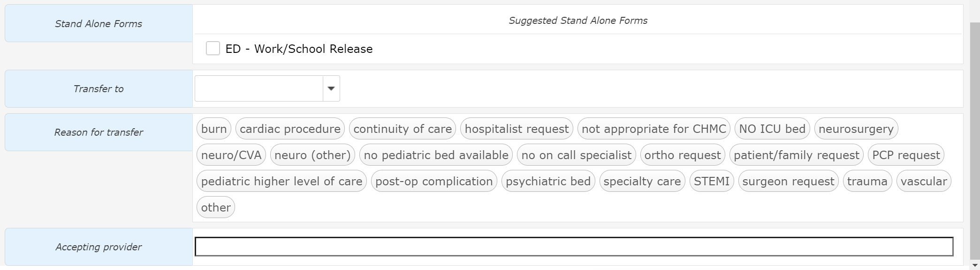
Universal Discharge
ED
The ED – Work/School Release form is visible but others are available
Transfer to – Hospital list
  May have to search by name due to list size
  This is a shared field which causes issues when multiple providers are signing Doc
Reason for Transfer – justification for transfer
Accepting provider – Receiving facility

